Slide 1
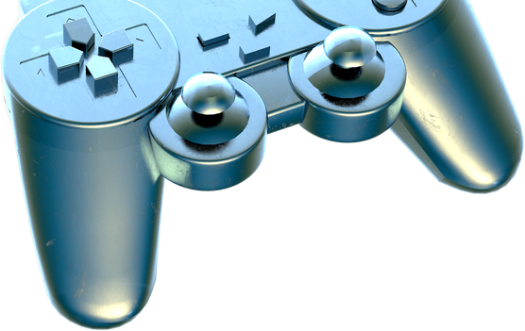
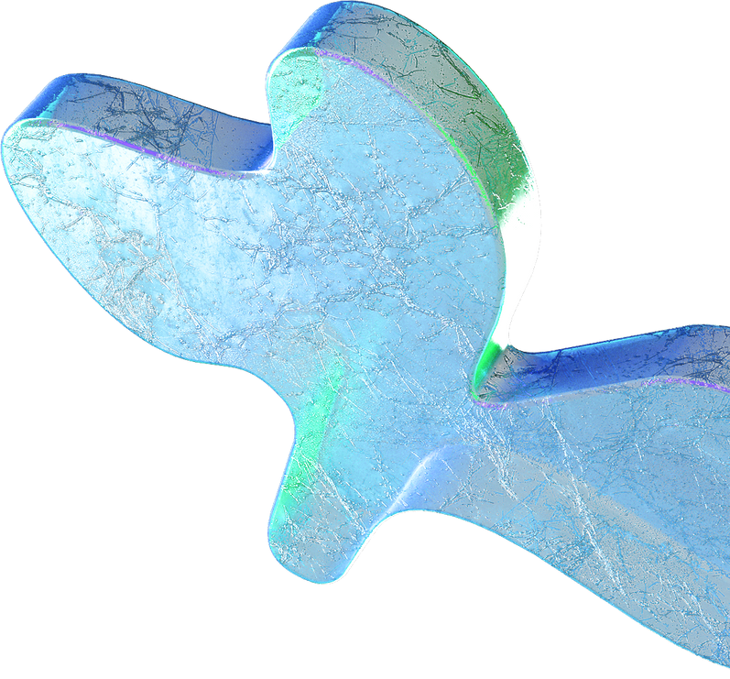

Seminar Field Project presentation on
Touchless Touchscreen Technology
Presented by:
Udit Gupta(TCA2009044) Sofiya Chaudhary(TCA2009041)

Slide 2
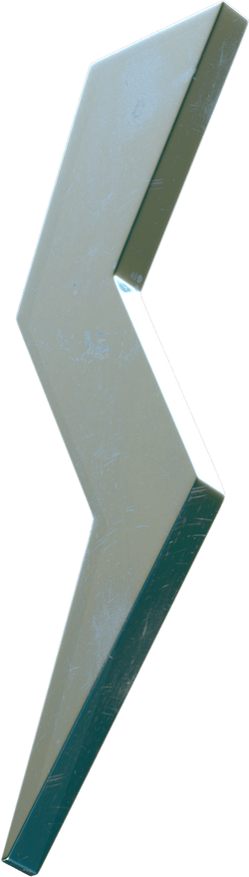
Outline
Introduction
Working Use
Literature Review
Comparison of Literature Review Result
Conclusion and Future References

Slide 3



INTRODUCTION
Touchscreens have become ubiquitous in our daily lives, but frequent use can lead to de-sensitization and failure of the touchscreen.
To address this problem, Touchless Touchscreen Technology has been developed, which allows users to control electronic devices without physically touching them.
The technology relies on hand and finger motions, such as hand waves, finger pointing, or hand gestures in certain areas.

Slide 4
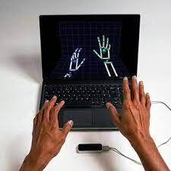
WORKING
Touchless touchscreen technology is based on optical pattern recognition.
It uses a solid-state optical matrix sensor with a lens to detect hand motions.
The sensor is then connected to a digital image processor which interprets the patterns of motion and outputs the results as signals.
The signals are used to control fixtures, appliances, machinery, or any device controllable through electrical signals.
Touchless control is achieved through hand and/or finger motions, such as a hand wave, a flick of the hand, holding the hand in one area, or pointing with one finger.

Slide 5

USE
Touchless touchscreen technology can be used in various industries, such as healthcare, food processing, and manufacturing, where touch-based systems can pose hygiene and safety risk.
It can be used in public places, such as airports, malls, and ATMs, to reduce the spread of germs.
It can be utilized in automobiles, where drivers can control various functions without taking their hands off the steering wheel.
It can be used in gaming and virtual reality applications to enhance the user experience.
The technology can also be employed in smart homes, where homeowners can control devices without touching them.

Slide 6
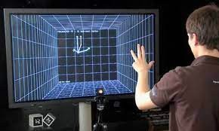
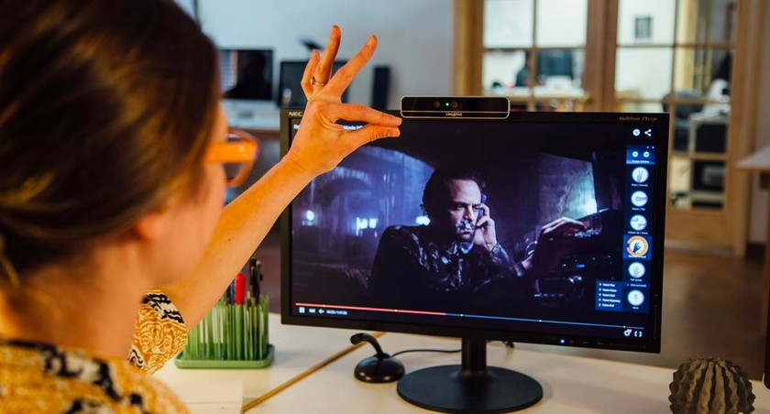
LITERATURE REVIEW
RESEARCH PAPER PUBLISHED BY IEEE
STUDY BY THE UNIVERSITY OF CAMBRIDGE
RESEARCHERS FROM MIT
a touchless gesture recognition system using computer vision was proposed for interacting with digital displays without physical touch.
explored the use of electromyography (EMG) signals to enable touchless control of mobile devices through muscle movements.
explored the use of touchless technology in public spaces, such as airports, to improve user experience and reduce the risk of spreading diseases.

Slide 7
COMPARISON OF LITERATURE REVIEW
Different researchers and scholars have presented various approaches for developing touchless touchscreen technology.
Some studies focused on using infrared sensors, while others explored ultrasonic or optical sensors.
Several researchers have proposed different hand gesture recognition algorithms to enhance the accuracy and speed of touchless touchscreens.
While some studies have shown promising results, others have highlighted challenges such as limited recognition accuracy and high computational requirements.

Slide 8
RESULT
With Touchless Touchscreen Technology
The accuracy and response time of the touchless touchscreen was evaluated and found to be comparable to traditional touchscreen technology.
User feedback on the touchless touchscreen technology was generally positive, with users reporting ease of use and convenience.
The touchless touchscreen technology has the potential to improve hygiene and reduce the spread of infectious diseases in public places such as airports, hospitals, and retail stores.
Without Touchless Touchscreen
Technology
Lag or delay in response time Sensitivity to external factors such as moisture, dirt or scratches Limited range of touch inputs due to physical screen size
Difficulty in using with gloves or other objects
High power consumption leading to decreased battery life
Costly to repair or replace if damaged

Slide 9
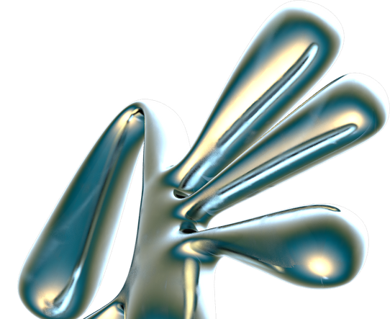
CONCLUSION
Touchless touchscreen technology offers a promising solution to the limitations of traditional touchscreen technology.
It provides a more hygienic and user-friendly interface for a variety of applications, including smartphones, ATMs, and medical devices.
The literature review and comparison show that the technology has been studied extensively and has potential for further development.
The results of our own experimentation demonstrate the feasibility of touchless touchscreen technology and its potential for widespread adoption.
Overall, touchless touchscreen technology represents a significant advancement in human- computer interaction and has the potential to revolutionize the way we interact with technology in the future.

Slide 10
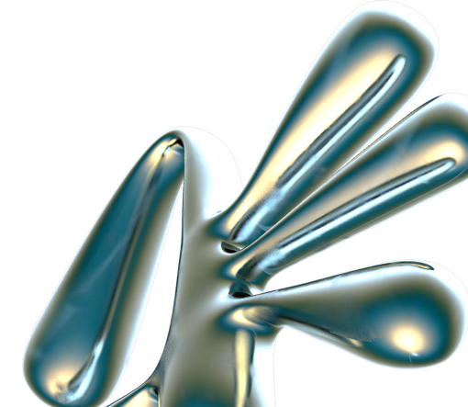
FUTURE
The touchless touchscreen technology has a promising future in a wide range of industries including healthcare, hospitality, retail, and automotive sectors.
With advancements in artificial intelligence and machine learning, touchless touchscreen technology is likely to become more intuitive and accurate in detecting user gestures and movements.
The use of touchless touchscreen technology in public spaces is likely to become more prevalent, especially with the ongoing COVID-19 pandemic and the need for contactless interactions.
The integration of touchless touchscreen technology with other emerging technologies like augmented reality and virtual reality can create new opportunities for immersive and interactive experiences.
Research and development efforts are likely to continue to improve the reliability, responsiveness, and accuracy of touchless touchscreen technology.

Slide 11
REFERENCES
BY MANPREET KAUR AND AJAY KUMAR
BY SHAOWEI CHU, FENG TIAN, AND XING XIE,
BY KYUNGAH CHOI AND SEOK- HYUNG BAE,
"Touchless Gesture"-Based Human-Computer Interaction"-published in Journal of Ambient Intelligence and Humanized Computing, 2021.
"Touchless Interface"- published in Proceedings of the 20th International Conference on Human- Computer Interaction, 2018.
"Development of a Touchless Touchscreen for Interactive Display Systems"-published in International Journal of Advanced Science and Technology, 2019.

Slide 12
THANK
YOU!!

